Slide 1


SDP
LECTURE
The Façade Pattern
Software Design Patterns
Diploma in IT
Year 2 (2024/25), Semester 4
9.2
Notes:
Hi everyone! The next design pattern we will be looking at is the Façade pattern. Yes, it’s pronounced façade even though it’s spelled fa-cade. It’s one of those fancy English words derived from the French language. The ‘c’ even has a little tail below it. Anyway, a façade is something you put in front of, say, a building, to make it look pretty and hides all the inner workings of the building like pipes and vents. As a software design pattern, the Façade pattern makes complicated code look pretty and makes it simpler to use.

Slide 2
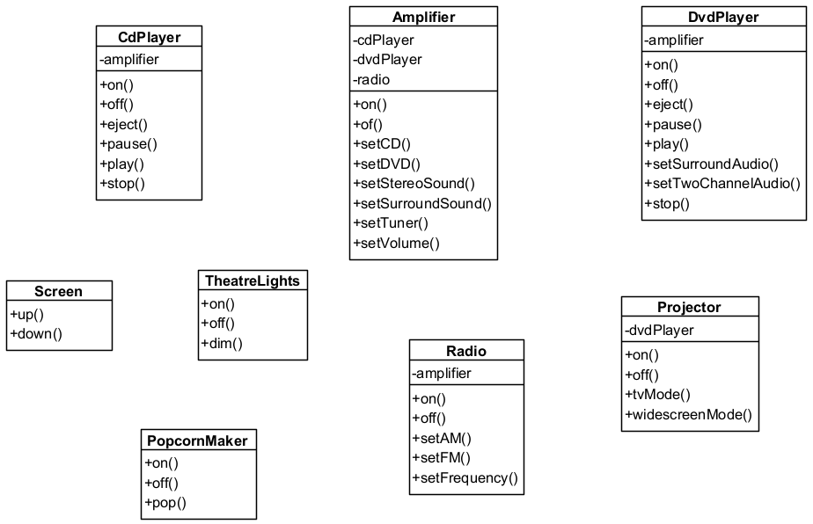
Awesome Home Theatre System
Notes:
Let’s see an example. Suppose you have built an awesome home theatre system that allows you to watch movies in comfort and luxury. You have a || top-of-the-line Amplifier that produces cinema-quality sound. You have it hooked up to a || CdPlayer in case you want to just play music. Your amplifier is of course also hooked up to a || DvdPlayer so that you can play your movie DVDs. But you don’t want to play your movie on a dinky TV, no, you have the DvdPlayer || connected to a Projector so that you can play the movie on your wall. And just for fun, you also have it hooked up to your || Radio, because why not? Other than that, you also have an || automated screen that you can raise and lower, and high-tech || theatre lights that you can dim for that cinema ambience. And for that fully authentic movie theatre experience, you even have your own || popcorn maker that can make fresh popcorn. Yes, yes, I know that home theatre systems these days will also be hooked up to some streaming service like Netflix, but I got this example from a textbook that was printed in 2004. Give me a break, ok?

Slide 3
Watching a Movie
Turn on the popcorn maker
Start the popcorn maker popping
Dim the lights
Put the screen down
Turn the projector on
Set the projector input to DVD
Put the projector on wide-screen mode
Turn the sound amplifier on
Set the amplifier to DVD input
Set the amplifier to surround sound
Set the amplifier volume to 5
Turn the DVD player on
Start the DVD player playing
Notes:
Right, so we’ve got our home theatre system set up and we’re ready to watch a movie. Now all we have to do is… (deep breath)
Turn on the popcorn maker
Start the popcorn maker popping
Dim the lights
Put the screen down
Turn the projector on
Set the projector input to DVD
Put the projector on wide-screen mode
Turn the sound amplifier on
Set the amplifier to DVD input
Set the amplifier to surround sound
Set the amplifier volume to 5
Turn the DVD player on
Start the DVD player playing
Phew! That’s a lot of steps.

Slide 4
Coding This Process
popper.on();
popper.pop();
lights.dim();
screen.down();
projector.on();
projector.setInput(dvd);
projector.widescreenMode();
amp.on();
amp.setDvd(dvd);
amp.setSurroundSound();
amp.setVolume(5);
dvd.on();
dvd.play(movie);
How do we
End the movie?
Listen to a CD?
Listen to the radio?
Notes:
And this is how we would code this. We turn the || popper on and start it popping, || dim the lights, || lower the screen, || turn on and setup the projector, || turn on the amp and set that up properly, and finally || turn the DVD player on and start it playing. I mean, it’s a lot of steps, but even though we know how to use method calls for each step, it will be pretty troublesome to do all these steps one by one everytime we want to watch a movie. Not only that, || it might be similarly troublesome to do things like end the movie, or listen to a CD or radio. Wouldn’t it be great if we had some kind of shortcut method that can run all these steps with one method call?

Slide 5
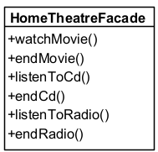
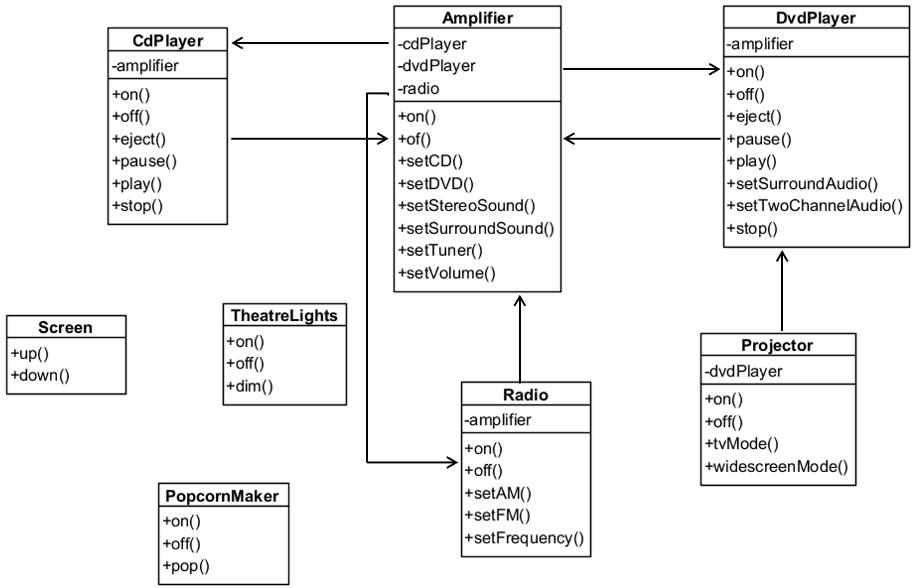
HomeTheatreFacade
Notes:
Yes, yes it would, and so we are going to create a class that contains all those shortcut methods called HomeTheatreFacade. Its job is to define shortcut methods that relate to our || home theatre system, and since it must call the various methods in our home theatre system components, it need to have || references to everything that it controls. So now all we have to do to watch a movie is to call the || watchMovie() method in our HomeTheatreFacade class, and we can have other methods to end the movie, listen to a CD, and so on.

Slide 6
HomeTheatreFacade
public class HomeTheatreFacade {
Amplifier amp;
Radio radio;
DvdPlayer dvd;
CdPlayer cd;
Projector projector;
TheatreLights lights;
Screen screen;
PopcornMaker popper;
Notes:
The HomeTheatreFacade class is actually a very straightforward class, it’s just…long. Firstly, because it is supposed to control everything in the home theatre system, it needs references to everything in that system.

Slide 7
HomeTheatreFacade
public HomeTheatreFacade(Amplifier amp,
Radio radio, DvdPlayer dvd, CdPlayer cd,
Projector projector, TheatreLights lights,
Screen screen, PopcornMaker popper) {
this.amp = amp;
this.radio = radio;
this.dvd = dvd;
this.cd = cd;
this.projector = projector;
this.lights = lights;
this.screen = screen;
this.popper = popper;
}
Notes:
We will initialize all these references in the constructor. Nothing fancy here.

Slide 8
Simplified Interface: watchMovie()
public void watchMovie(string movie) {
Console.WriteLine(“About to watch a movie...”);
popper.on();
popper.pop();
lights.dim(10);
screen.down();
projector.on();
projector.setInput(dvd);
projector.widescreenMode();
amp.on();
amp.setDvd(dvd);
amp.setSurroundSound();
amp.setVolume(5);
dvd.on();
dvd.play(movie);
}
Notes:
Now, let’s write some shortcut methods. The first one is watchMovie(), which goes through our 13-step process. We add a bit more detail, like the name of the movie and the fact that we dim the lights down to 10%, but otherwise it’s just the same process we were talking about before.

Slide 9
Simplified Interface: endMovie()
public void endMovie(string movie) {
Console.WriteLine(“Shutting down theatre...”);
popper.off();
lights.on();
screen.up();
projector.off();
amp.off();
dvd.stop();
dvd.eject();
dvd.off();
}
}
Notes:
We can also write one to end the movie, which turns off the popcorn maker, turns on the lights, raises the projection screen, turns off the projector and amp, and stops and ejects the DVD player before turning it off as well. In the same way, we could write methods to do other things like listen to a CD or a radio. Note that these methods essentially provide a simplified interface to the home theatre system – you just have to call a single method to do multiple steps instead of having to call each individual method yourself.

Slide 10
Let’s Test It
public class HomeTheatreTest {
// instantiate components here
public void testTheatre() {
HomeTheatreFacade homeTheatre =
new HomeTheatreFacade(amp, radio, dvd, cd,
projector, screen, lights, popper);
homeTheatre.watchMovie(“The Princess Bride”);
homeTheatre.endMovie();
}
}
Notes:
And that’s all there really is to it. Let’s test this out using a class called HomeTheatreTest. First, we || instantiate all the individual components of the home theatre system, and || use those components to initialize our HomeTheatreFacade object. After that, we can just call || homeTheatre.watchMovie(), and we’re going to watch a good movie. If you haven’t seen The Princess Bride, you really should check it out. After that, we also call || homeTheatre.endMovie().

Slide 11
Output of watchMovie()
About to watch a movie...
Popcorn maker on
Popcorn maker popping popcorn!
Theatre lights dimming to 10%
Theatre screen going down
Projector on
Projector in widescreen mode
Amplifier on
Amplifier setting to DVD
Amplifier surround sound on
Amplifier setting volume to 5
DVD Player on
DVD Player playing “The Princess Bride”
Notes:
So if we call the testTheatre() method, this should be the output. The watchMovie() method will go through our 13-step process to watch a movie…

Slide 12
Output of endMovie()
Shutting down theatre...
Popcorn maker off
Theatre lights on
Theatre screen going up
Projector off
Amplifier off
DVD Player stops playing “The Princess Bride”
DVD Player ejects
DVD Player off
Notes:
And the endMovie() method will go through our other process to end the movie. Simple, right?

Slide 13
The Façade Pattern
Notes:
That’s the Façade design pattern. It really is this straightforward. Let’s introduce it formally.

Slide 14
Definition
The Façade Pattern:
Provides a unified interface to a set of interfaces in a subsystem
Defines a higher-level interface that makes the subsystem easier to use
Notes:
The Façade pattern takes a set of interfaces in a subsystem and provides a unified interface. We call it a subsystem because, for example, our home theatre system is a subsystem within our main program. Essentially, the Façade pattern defines a higher-level interface that is intended to make the subsystem easier to use.

Slide 15
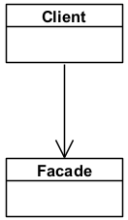
The Façade Pattern
Subsystem classes
Notes:
This is the class diagram for the Façade pattern, and as you can see, it doesn’t look like the other class diagrams we have looked at before. This is because the Façade class sort of sits on top of an entire subsystem, and it can have references to multiple classes within the system, so there isn’t really a single way to draw the class diagram. But the point is that a || Client class that wants to use the subsystem can use the Façade class’s simplified interface to help it use the subsystem, although note that the Client class is not officially part of the Façade pattern class diagram.

Slide 16
Key Participants
Façade
Knows which subsystem classes are responsible for a request.
Delegates client requests to appropriate subsystem objects.
Subsystem classes
Implement subsystem functionality.
Handle work assigned by the Façade object
Have no knowledge of the Façade (i.e., do not keep a reference to it)
Notes:
In other words, the Façade pattern only has two key participants. The first is the || Façade itself, which simplifies complicated requests for a subsystem. It knows which subsystem classes are responsible for each part of the request, and will delegate these steps to the appropriate subsystem objects. The other key participant are the || subsystem classes, and all it does is implement subsystem functionality. The Façade object will call the methods defined by the subsystem classes, and the subsystem classes have no idea that they are being called by a Façade.

Slide 17
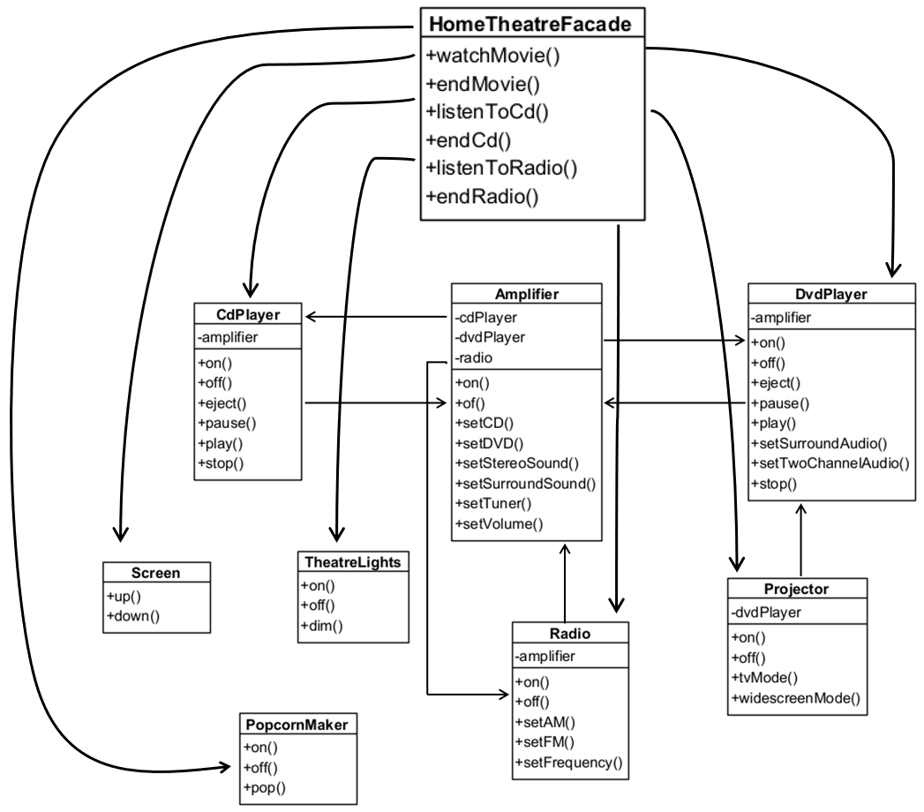
Applying Façade to Home Theatre
Facade
Subsystem classes
Notes:
For completeness, here is how our HomeTheatreFacade maps to the Façade design pattern class diagram. || This is the Façade, and || this is the subsystem.

Slide 18
What Have We Achieved?
Clients are shielded from subsystem components
Reduces number of objects that clients deal with
Makes the subsystem easier to use
Promotes weak coupling between subsystem and clients
Allows varying of subsystem components without affecting clients
Does not prevent using subsystem classes if necessary
Notes:
And that’s the Façade design pattern. What have we achieved? Ultimately, the || clients that use the subsystem components can now do stuff without having to know the low-level details of the subsystem. By using a Façade, the clients can deal with the Façade and not the subsystem itself, which also makes the subsystem easier to use. By doing so, we have || reduced the coupling between the subsystem and its clients, and we can vary the subsystem components without affecting the clients. For example, if we replace our projector with a new one that uses different method calls, then we only have to change the methods in the Façade class to accommodate it, and the clients are completely unaffected. Note that || since the Façade is an additional class that sits on top of the subsystem, it doesn’t prevent other clients who actually want to access the subsystem classes directly from doing so.

Slide 19
Another Design Principle
Principle: “Principle of Least Knowledge”
Talk only to your immediate friends
Objects should only communicate with
Itself
Objects pass in as a parameter to the method
Objects the method creates
Attributes and references of the object
Also known as the “Law of Demeter”
Notes:
Since the Façade pattern is so easy, now is a good time to introduce another design principle that is one of the motivating factors behind the Façade pattern. The principle is called || The Principle of Least Knowledge, and is often expressed as “talk only to your immediate friends”. Wait, what? What does a friend mean in the context of OO programming? Well, a friend in this case is an object that you are directly referencing. Essentially, this principle says that || methods in an object should only communicate with 4 categories of other objects: || the object itself, || objects that are passed to the method as a parameter, || objects that the method creates in its code, and || attributes and references of the object. What this principle says is that you should only communicate with these friends, and you should not communicate with friends of friends. Incidentally, this principle is also known as the || Law of Demeter, named after the Greek goddess of agriculture for the way seeds spread and grow from a local area. Anyway, the Law of Demeter and the Principle of Least Knowledge are the same thing.

Slide 20
What the Principle Recommends
Not following the principle:
Following the principle:
public float getTemperature() {
Thermometer thermometer = station.getThermometer();
return thermometer.getTemperature();
}
public float getTemperature() {
return station.getTemperature();
}
Notes:
What are the implications of this principle? To illustrate, consider || this code that retrieves the current temperature from a weather station. It first creates a Thermometer object using the station’s getThermometer() method, and then returns the thermometer’s temperature. The problem here is that the method is only friends with the station, not its thermometer, so calling the theremometer’s getTemperature() method violates the Principle of Least Knowledge. Instead, we should code it in || this way, by creating a getTemperature() method in the weather station class. We will let the station return the current temperature in its own way, and if it changes its thermometer system, this method will not be affected.

Slide 21
A Good Example
public class Car {
Engine engine;
public void start(Key key) {
Doors doors = new Doors();
bool authorized = key.turn();
if (authorized) {
engine.start();
updateDashboardDisplay();
doors.lock();
}
}
Class attribute.
Object passed in as parameter.
Created object.
Local method.
Notes:
Here’s an example of a piece of code that follows the Principle of Least Knowledge properly. This is a Car class, and it contains a || reference to an Engine object. It has a method called start that || takes a Key object as its parameter. Within this method, it creates a || new Doors object. Now, since the key object is a passed in parameter, you are allowed to || call the methods in the key object, such as turn() in this case. Since the engine is an attribute, you can || also call its methods, in this case, start(). You can always || call methods in the Car object itself, such as the updateDashboardDisplay() local method. Finally, because you created the doors object within this method call, you are allowed to || call the methods in this created object such as lock(). So this code does not violate the Principle of Least Knowledge.

Slide 22
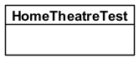
Façade Follows the Principle of LK
This client only has one friend.
We can change the home theatre components without affecting the client.
Notes:
How does this relate to the Façade design pattern? Well, note that the || HomeTheatreTest object that we used to test the system is the client, and it only refers to the HomeTheatreFacade object, and not to any of the individual home theatre components. Looking at this class diagram, we see that our || HomeTheatreTest class only has one friend, which is the Façade. Therefore, it will only call the Façade methods and not any of the subsystem methods. This has the clear benefit that || if we change any of the home theatre components, then HomeTheatreTest is completely unaffected because the job of figuring out how to watch a movie is given entirely to the Façade class.

Slide 23
Pros and Cons of Principle of LK
Advantages
Reduces dependencies between objects
Simplifies system maintenance
Disadvantages
Results in more “wrapper” classes or methods
May result in increased complexity and development time
May cause decrease in runtime performance
Notes:
Like most design principles, it’s not all upside. Yes, || the main advantage of reducing dependencies between objects thereby simplifying system maintenance is a big one, and usually it is worthwhile to follow this principle. However, it comes with a few || disadvantages. The main way to avoid having to talk to a friend of a friend is to have a “wrapper” class or method handle this, like having the weather station object define a getTemperature() method. Adding all these wrapper classes or methods may increase the complexity of the system, and therefore increase the development time. Also, the fact that you have to call an additional wrapper method does have a slight effect on runtime efficiency, which is usually not a big deal unless you have some system where every microsecond counts. That said, the general consensus is that for most systems, the Principle of Least Knowledge is a good one to follow.

Slide 24
Summary
The Façade design pattern
The Principle of Least Knowledge
Notes:
And that was the Façade design pattern, that provides a simplified interface to a subsystem. We also introduced the Principle of Least Knowledge that says that you should only directly communicate with your immediate friends, at least when it comes to OO programming.
You know, it took me a very long time to learn how to pronounce “façade” properly, in fact, it took me 10 years to figure it out. That’s right, it took me a de-sade. Byee!

